Slide 1
Interpolation using Lagrange and Newton Forward Formula
Project Members:
Taimoor Abid(11954)
Maaz Ullah Warsi(11832)

Slide 2
Introduction:
Interpolation is the process of using points with known values or sample points to estimate values at other unknown points. It can be used to predict unknown values for any geographic point data, such as elevation, rainfall, chemical concentrations, noise levels, and many more. There are many types of interpolation, but we have used two types Lagrange Interpolation And Newton Forward Method to find the missing value in between the given set of values.

Slide 3
Lagrange Interpolation:
The Lagrange interpolation formula is a way to find a polynomial which takes on certain values at arbitrary points.
Newton Forward Formula:
Newton Forward Interpolation is the technique of estimating the value of a function for any intermediate value of the independent variable.

Slide 4
Working:
We have made this project using Python Language. This project is GUI based which is done using tkinter. When we run this project it open up a window on which first it asks about which method do you want to use for finding the value, then it asks for total number of Value of X and Y and it generates an array in the backend according to our input for example if we enter 4 it will generate two arrays of 4 one for values of x and second for values of Y. Now we will enter values of X and Y in the given box. When we will enter value of X0 and enter the save button it will save the data and will ask for next value like X1 X2 so on. Then we will enter the point of which we want to find the value, or we can get the equation instead.

Slide 5
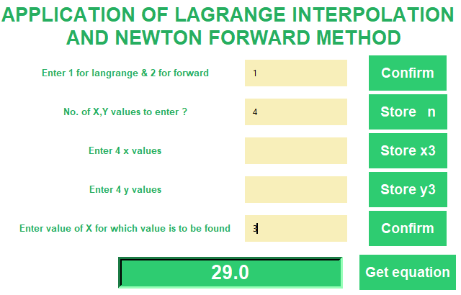
GUI Screen Shots:
Solving the Question Using Lagrange Method:
X | 1 | 2 | 4 | 5
Y | 5 | 11 | 65 | 125

